Slide 1

Investigating the Role of Collaboration in Success:
A Network Analysis of Passing in the 2021-22 NBA Season
Brandon Wallace

Slide 2
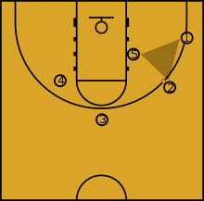

Big Idea
Do teams which collaborate more frequently perform better than teams which collaborate less frequently?
Do NBA Teams who pass more frequently perform better than others who pass less frequently?
“How many times are we going to pass before we shoot?” …
“How many?!”
-”Four!”

Slide 3

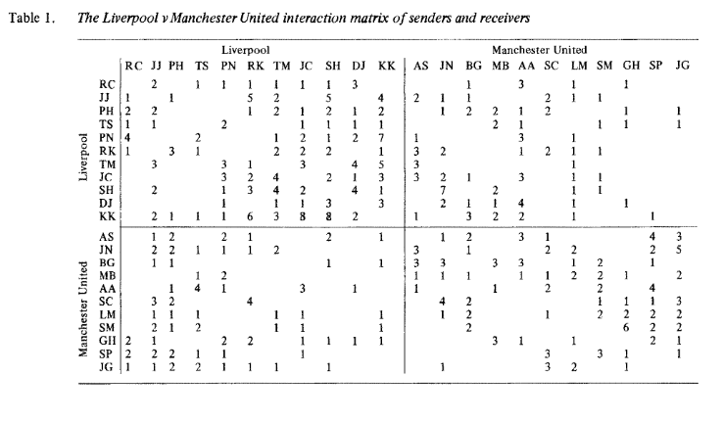
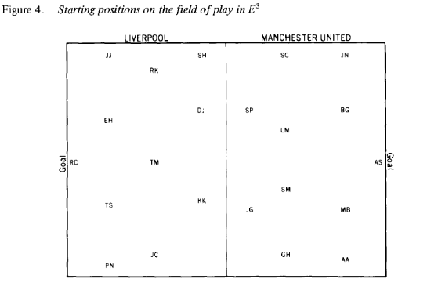
Previous Research
(Gould and Gatrell, 1979)

Slide 4
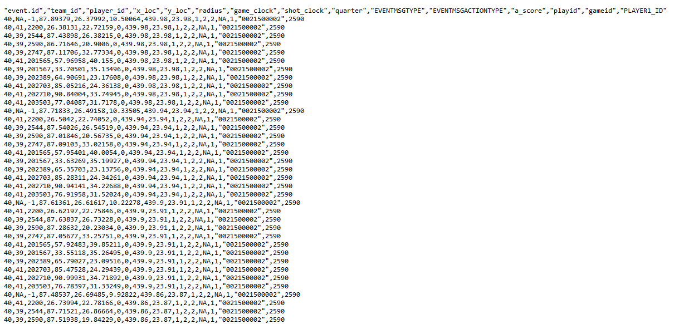


SportVU Revolution

Slide 5
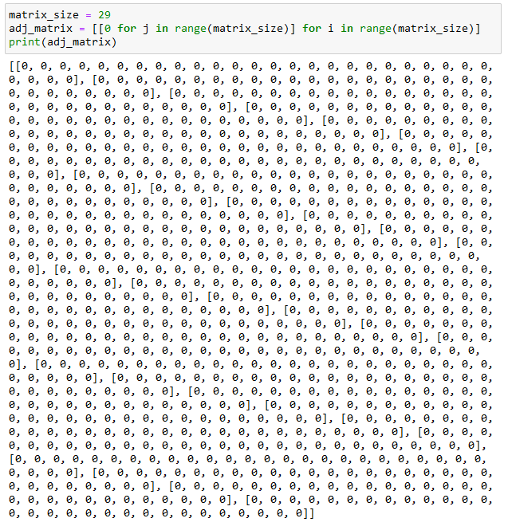
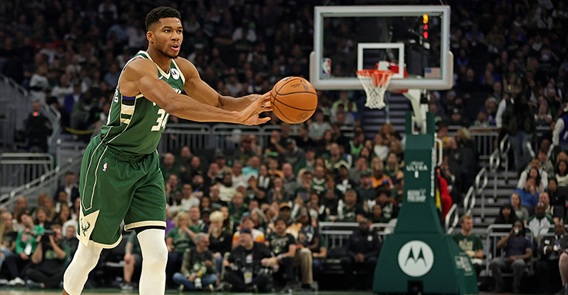

Slide 6
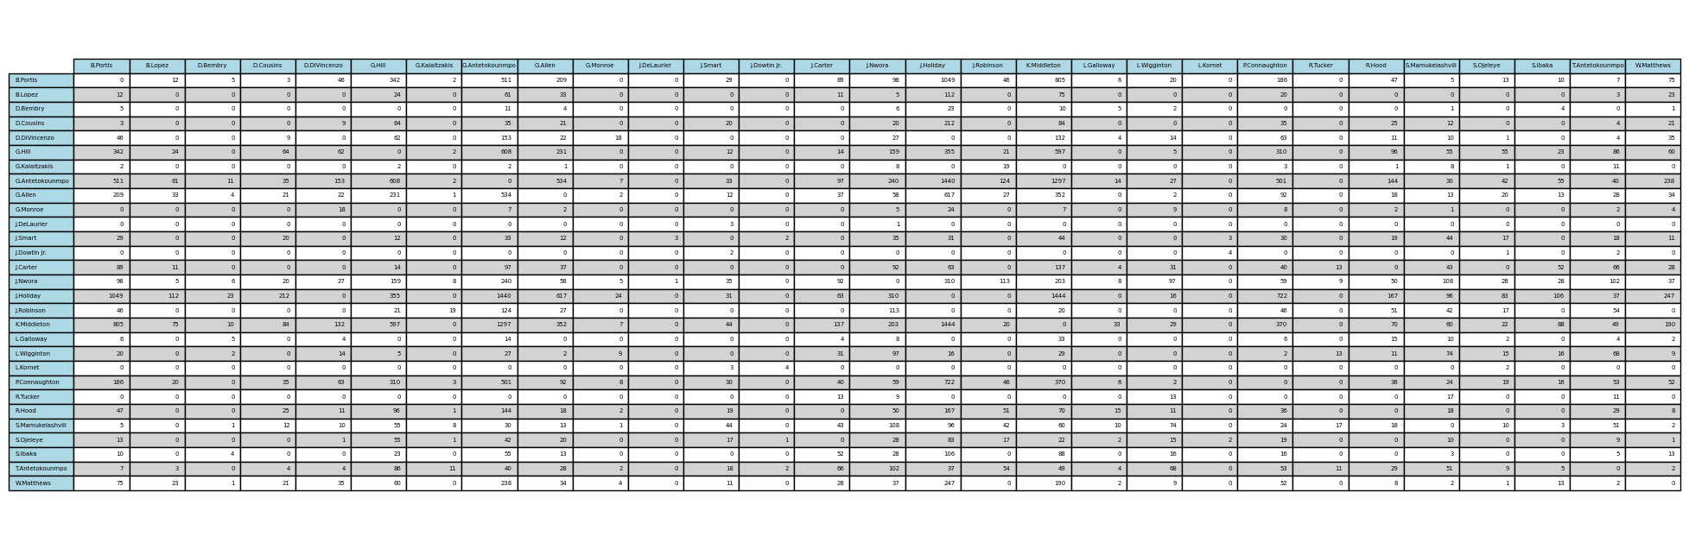
Construct a network of all players where the weight between nodes is the number passes exchanged over the 2021-22 NBA Season

Slide 7
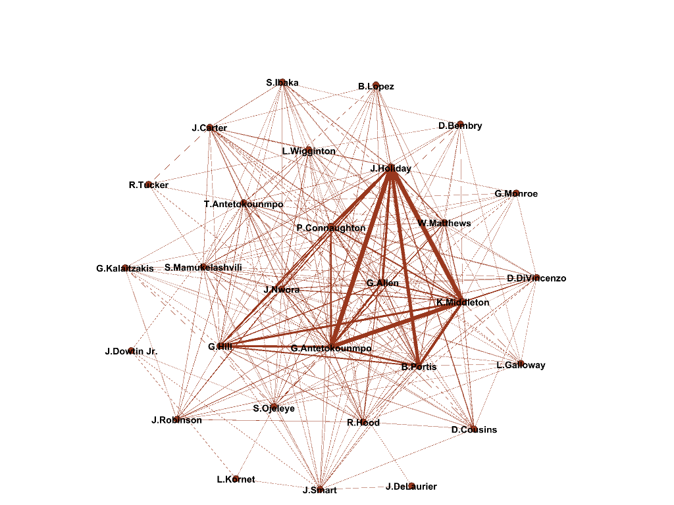
Passing Networks Graphs

Slide 8

Constructed Metrics
Per Team
Total Passes (count of all successful passes exchanged between players)
Total Assists (count of all assists recorded by any player on the team)
Passes Per Assist on Average (Total Passes / Total Assists)
Per Team
Total Wins
Outperformance (preseason power ranking - ordered finish before playoffs by record)

Slide 9
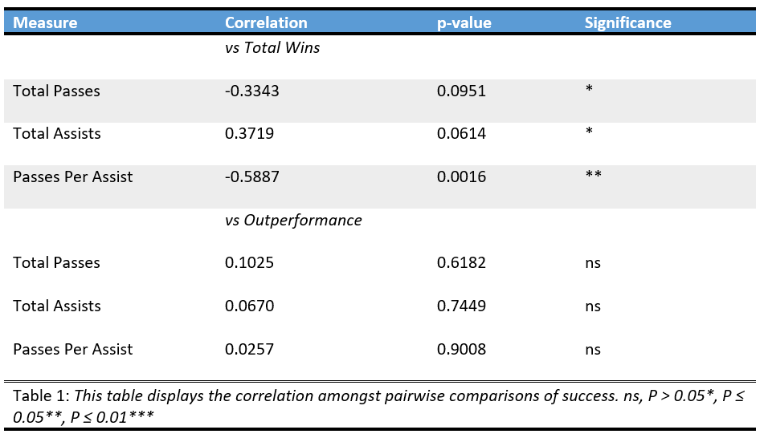
Passing and Winning

Slide 10
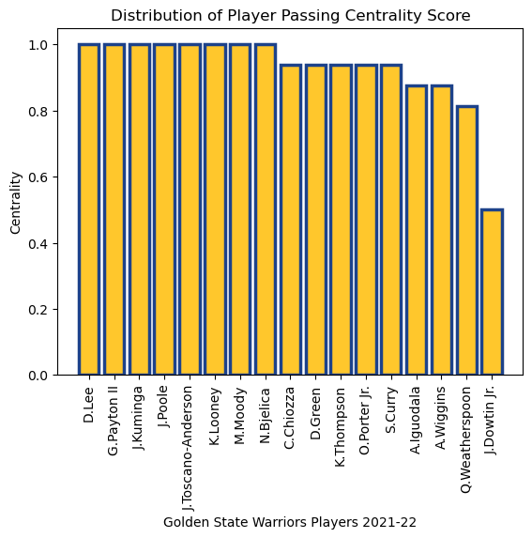
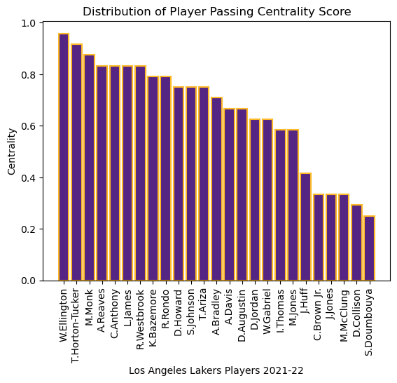
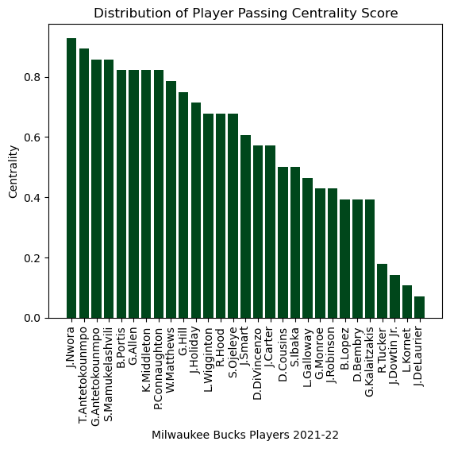
Passing Distribution by Team

Slide 11
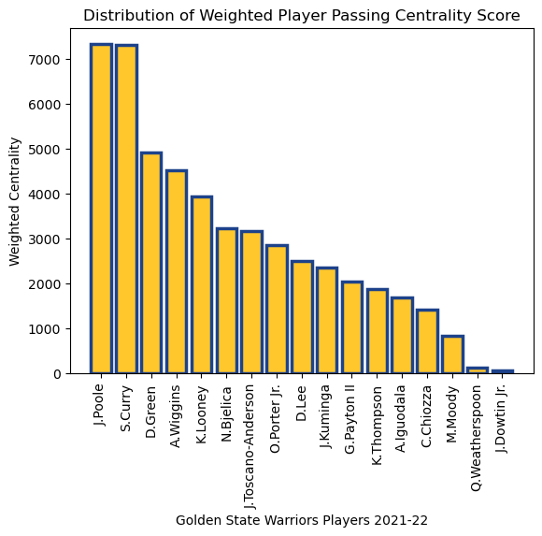
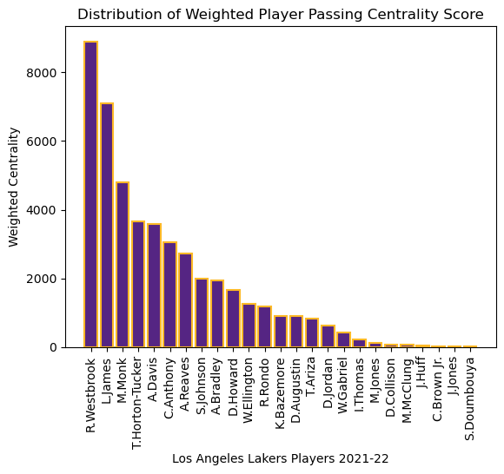
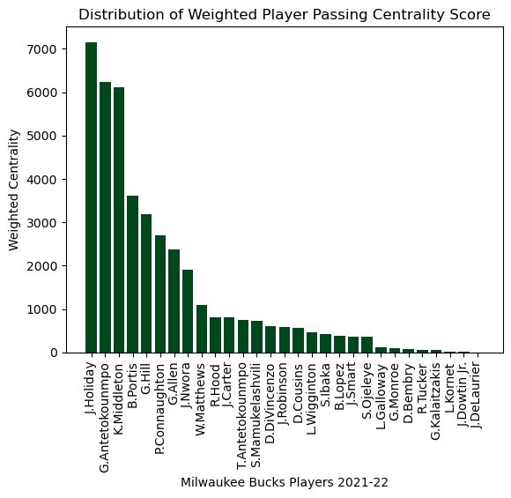
Passing Distribution by Team (weighted)

Slide 12
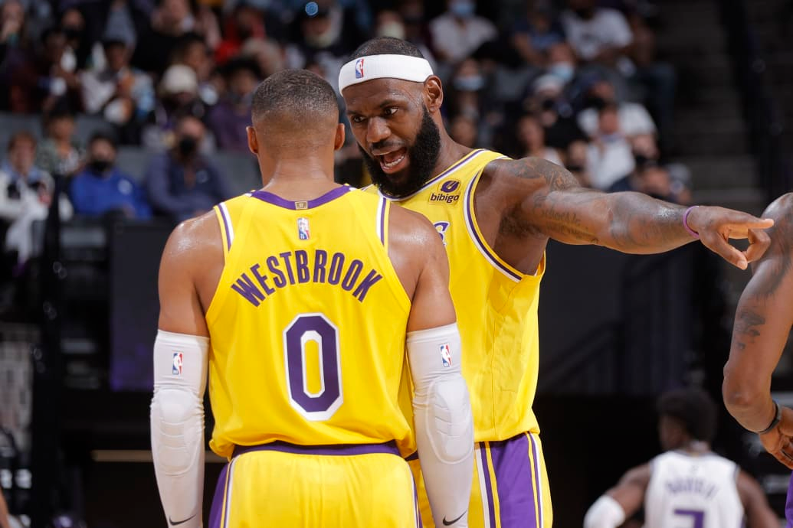
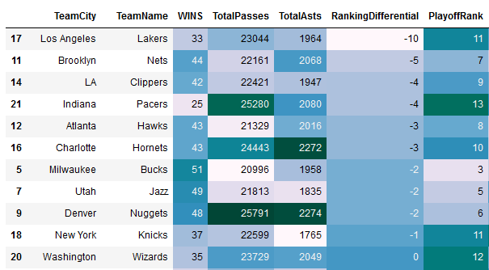
Offensive Entropy

Slide 13
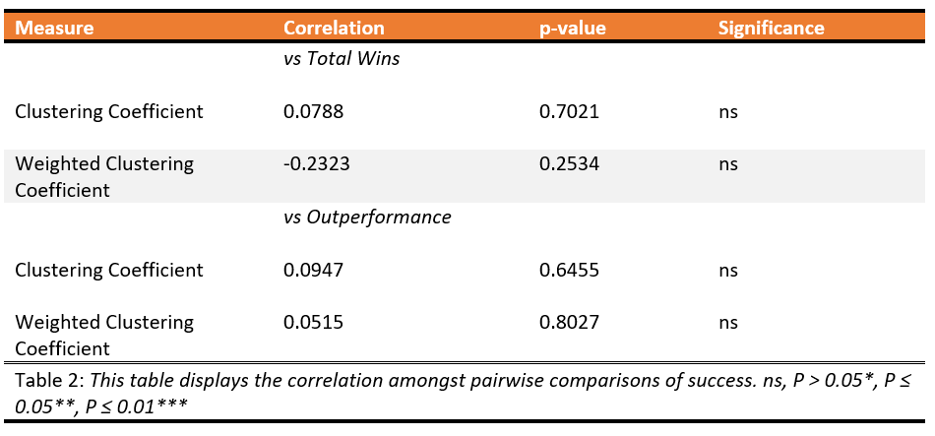
Network Characteristics and Winning

Slide 14
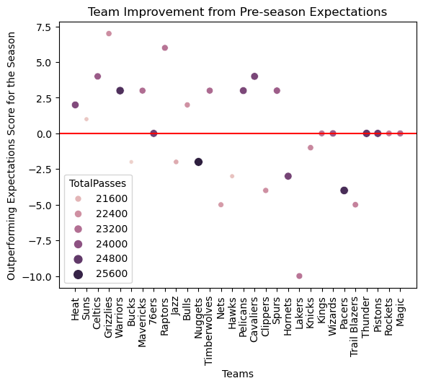
Predictability?
Highest Centrality and Weighted Centrality?
The 2021-22 NBA Champion Golden State Warriors
OLS Multivariate Regression
F Score: 2.307
p-Value: 0.0828
Adj R^2: 0.207
Durbin Watson: 0.688

Slide 15
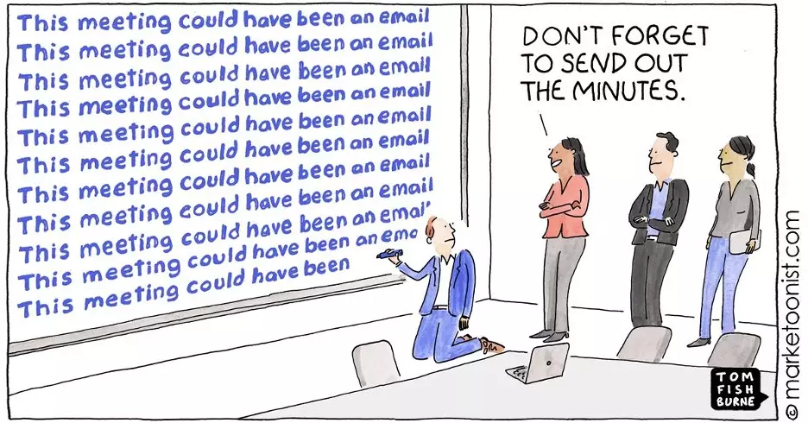
Conclusion
Inconclusive Results
Passing May Help Overcome Talent Deficiency
Limited Generalizability beyond Basketball

